Slide 1









Whiteboardmaths.com
7
2
1
5
© 2004 All rights reserved

Slide 2
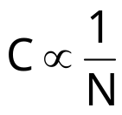
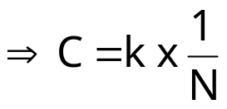
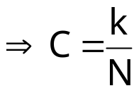

Inverse Proportion
If two quantities are related in such a manner that if one quantity increases by a factor k and the other decreases by a factor of 1/k then the quantities are said to be inversely proportional.
120
110
100
90
In the case of hiring the van we say that
80
70
Two people, half the cost
Cost (C)(£)
The product C x N is constant and the points lay on a curve of the form y = 1/x
60
50
Three people, third the cost etc
40
Vera’s Van Hire
£120 per week
30
20
10
0
1
2
3
4
5
6
7
8
Number of People (N)

Slide 3

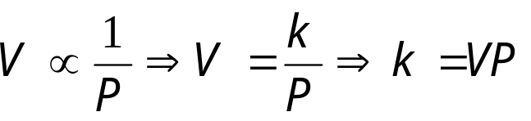
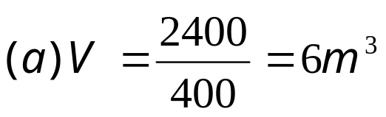

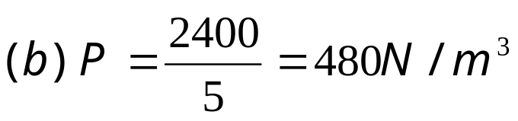
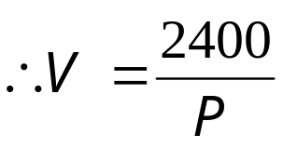
Example Question 1
Boyle’s Law states that at constant temperature, the volume V of a gas is inversely proportional to its pressure P. When the pressure is 600 N/m² the volume is 4m³. Find:
(a) The volume when the pressure is 400 N/m²
(b) The pressure when the volume of the gas is 5 m³
Remember: Strategy for solving proportion problems
1. Find the value of k (the constant of proportionality).
2. Use k together with given values to answer the question.

Slide 4
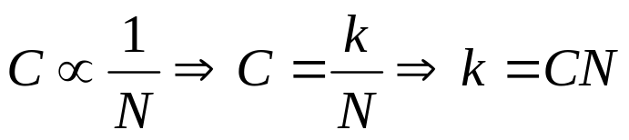
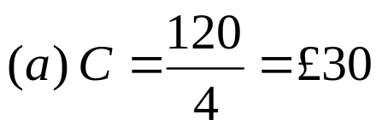

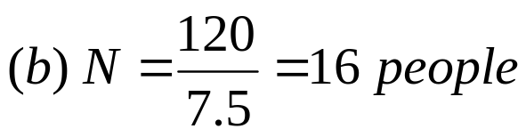
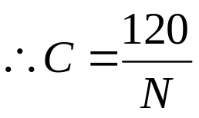
Question 1
The cost C of hiring a transit van is inversely proportional to the number of people N, hiring it. If Robert hires the van himself, the cost will be £120. Find:
(a) The cost per person if a party of 4 people hire the van.
(b) The number of people hiring the van if the cost per person is £7.50.

Slide 5

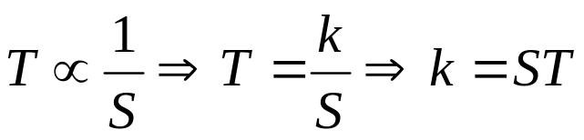


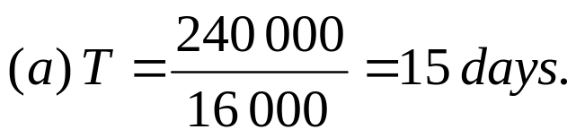
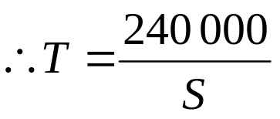
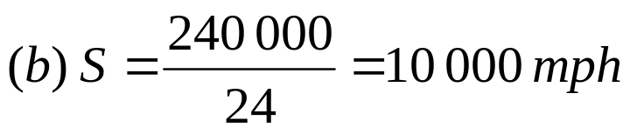
Question 2:The time T, taken for a journey to the moon is inversely proportional to the average speed S, of the space ship. If the trip takes approximately 20 days at an average speed of 12, 000 mph, find:
(a) The time taken at an average speed of 16 000 mph.
(b) The average speed for a journey completed in 24 days.

Slide 6
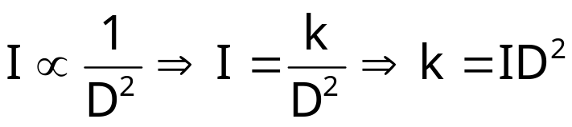
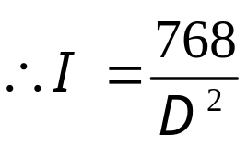

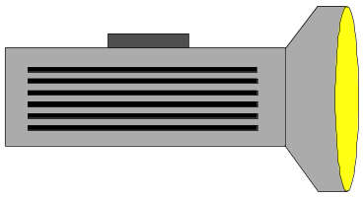
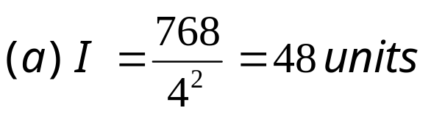
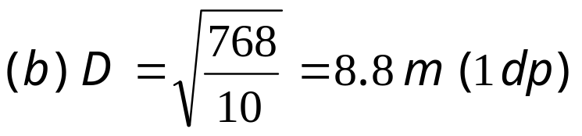
One quantity can be inversely proportional to the square or cube of another.
Question 3. The Intensity I of light falling on an object varies inversely as the square of the distance D of the object from the light source. If the intensity of light is 12 units at a distance of 8 m, find:
(a) The intensity at a distance of 4 m.
(b) The distance of the light source from the object if the intensity is 10 units.
8 m

Slide 7
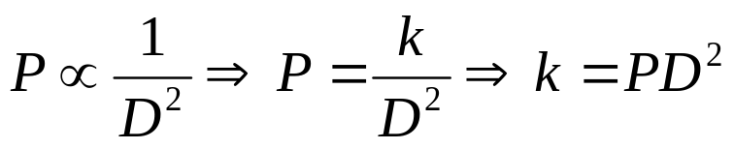
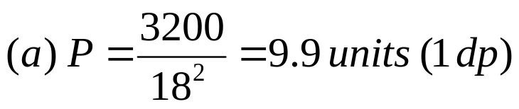

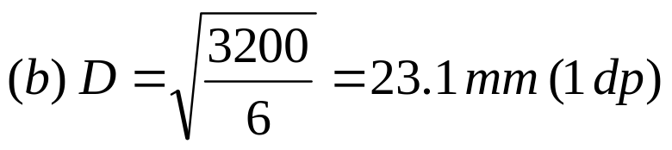
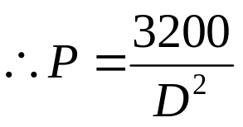
Question 4
The air pressure P that is delivered by a bicycle pump is inversely proportional to the square of its diameter D. If 8 units of pressure is delivered by a 20 mm diameter pump, find:
(a) The pressure delivered by an 18 mm pump.
(b) The diameter of a pump delivering 6 units of pressure.

Slide 8


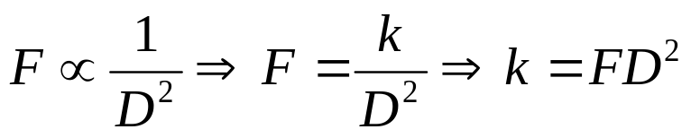
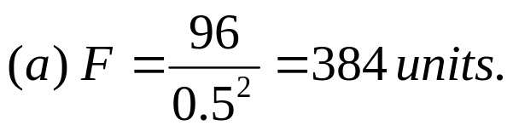

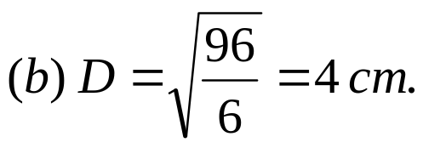
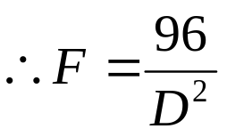
Question 5
The force of attraction F, between two magnets is inversely proportional to the square of their distance apart D. When the magnets are 2 cm apart the force of attraction is 24 units. Find:
(a) The force of attraction between two magnets that are 1/2 cm apart.
(b) The distance between two magnets when the force of attraction is 6 units.

Slide 9
Example Question 1
Boyle’s Law states that at constant temperature, the volume V of a gas is inversely proportional to its pressure P. When the pressure is 600 N/m² the volume is 4m³. Find:
(a) The volume when the pressure is 400 N/m²
(b) The pressure when the volume of the gas is 5 m³
Question 1
The cost C of hiring a transit van is inversely proportional to the number of people N, hiring it. If Robert hires the van himself, the cost will be £120. Find:
(a) The cost per person if a party of 4 people hire the van.
(b) The number of people hiring the van if the cost per person is £7.50.

Slide 10
Question 2:
The time T, taken for a journey to the moon is inversely proportional to the average speed S, of the space ship. If the trip takes approximately 20 days at an average speed of 12, 000 mph, find:
(a) The time taken at an average speed of 16 000 mph.
(b) The average speed for a journey completed in 24 days.
Question 3.
The Intensity I of light falling on an object varies inversely as the square of the distance D of the object from the light source. If the intensity of light is 12 units at a distance of 8 m, find:
(a) The intensity at a distance of 4 m.
(b) The distance of the light source from the object if the intensity is 10 units.

Slide 11
Question 4
The air pressure P that is delivered by a bicycle pump is inversely proportional to the square of its diameter D. If 8 units of pressure is delivered by a 20 mm diameter pump, find:
(a) The pressure delivered by an 18 mm pump.
(b) The diameter of a pump delivering 6 units of pressure.
Question 5
The force of attraction F, between two magnets is inversely proportional to the square of their distance apart D. When the magnets are 2 cm apart the force of attraction is 24 units. Find:
(a) The force of attraction between two magnets that are 1/2 cm apart.
(b) The distance between two magnets when the force of attraction is 6 units.

